Slide 1
1st lecture
THE MAIN PRIORITIES IN WORK WITH ERI 1. RIGHT SITE OR LEFT SITE ? The PRIORITY is the RIGHT SITE. It represents the Automatic algorithm - offered by ERI judgments 2, Compensation involves max 27 markers. Less markers higher efficiency 3. The SOMATIC indexes: + / The PSYCHOSOMATIC indexes: - +100 -100 and THEIR COMBINATORIAL POSSIBILITIES AND RESULTS - MEANING The Average and good status of Analysed systems: between -50 and +50. The optimal values are +10/-10 - and it means psycho - somatic balance.

Slide 2
4. The Information - when we are using the Markers for the following Analysing or for the Compensation is: -100 and + 100 Psxchosomatic: -100 Somato-psychic: +100 ————————————- LEFT SIDE: 1st Line: Psychosomatic and Somatic Issues: When higher Absolute Value of Somatic Index: +: + 100: we go to Somatic parts of analyses: LEVEL / Left side: ECM TOXINS and Patogens etc .. all relevant functions and information When higher Absolute Value of Psychosomatic Index: - : -100: We check on Left side: Psychological Defence Mechanism Psychological Loads or Necroses, Stress etc

Slide 3
When higher Absolute Value of Psychosomatic Index: + : +100: We check on Left side: Psychological Characteristics /anything connected to Characteristic issue of Organism/ Another specific Functions with Marker Index: - Functions of brain: Induction Program -100 Optimal Activity of the Brain: -100 Combinatorial indexes: Low energy in C joints or Complexes: -100 Higher energy +100 = all those in Orrange zones are subject of compensation /how… and when../ Jurgs: -100 BUT: Degenerative Jurgs: +100 AND: Acupuncture: +100 or -100 OR Combinatorial Centers +100 or -100 /from the bottom/

Slide 4
5. Colours in ERI and their Priorities We mostly care about ORANGE ZONES: UPPER ORRANGE zone is a PRIORITY. If there is not Upper Orrange Zone - then last ONE in LOWER Orrange Zone If there is not Orrange Zone at all, but only GREEN and YELLOW, the we check the GREEN. If there is only YELLOW, then we check YELLOW. BUT: We Compensate only ORANGE Zone /or White/. Never GREEN, YELLOW or RED.

Slide 5
Priority: Yellow for further analyses
Upper Orrange Zone /UOZ/ for Compensation /C/or Analysing /A/
Upper White Zone for C or A
UOZ for C or A

Slide 6
UOZ /even though all of them are saying the same, huge Viral infection/
Green Zone for A
Low Orrange Zone for C or A /depending of which ERI program is used/

Slide 7
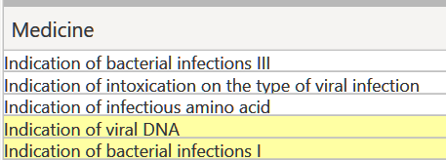
Yellow Zone for A
Low Orrange Zone for C or A /depending on which ERI program is used/
Lower Yellow Zone for A

Slide 8
When we use HIGHER level of ERI programs for aetiology we open equivalent Category /Bacteria, Fungus, Viruses/ and we Compensate always the Marker closest to GREEN ZONE from the UOZ, and we can also move it to LEVEL and find an ALLOPathy, Homeopathy or another way of Treatment.
We can also move GREEN market instead of lower Orrange one to LEVEL and find a Treatment from the Left side offer.
In Pathogens we choose for Compensation only Upper Orrange Zone - the market closest to the Green zone. It will fix all upper markers as well.

Slide 9
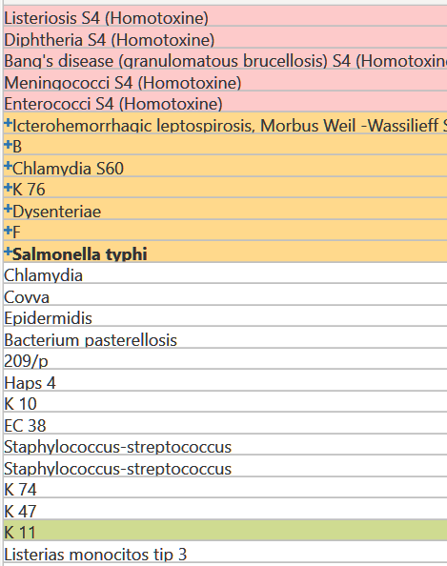
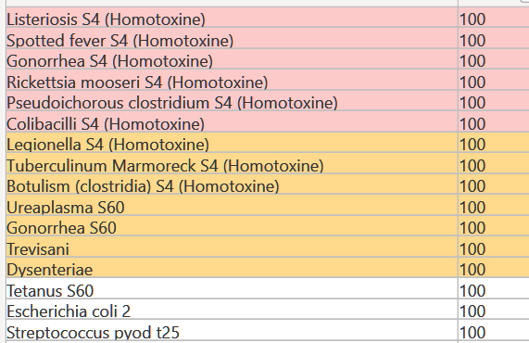

Slide 10
Important:
We always Compensate: +100 or - 100 from Lower Bottom of Upper Orrange Zone
/in cases Lower Bottom Marker from Lower Orrange Zone/
We never compensate from Green Zone , Yellow Zone or Red Zone
We can only put onto LEVEL - if Markers from those Zones.
6. ECM - Extracellular Matrix and its meaning
There are 3 Major Zones:
ECM 1 - Cardio / Blood circulation
ECM 2 - Lymphatic circulation
ECM 3 - Nerves
3 Layers of the Extracellular Matrix can open more infos about the status of the Organism and main cores of possible .
Additional Information:
If we are in Nerve and we get 3rd layer of ECM: We put for Compensation /C/ MYELIN.
If we are in Cardio Structures and we get ECM 1 /Blood/ we put for C only this Layer. It is like a marker.

Slide 11
7. INDEXES
When we do Analyses of the Organs we check the Index characteristics: 1, 2 or No index.
If there is Index 1 or 2 we usually check on the Left side:
psychological reactions
alkanility/acidity
ECM
etc.
If there is INDEX 2, we ALWAYS go to aetiology and check it for the whole organ /we don't need to find in ECM/
If we get MARKER without any INDEX /1,2 or so/ we go to PSYCHO-NEURO-IMUNO-ENDOCRINE-S. And we check and put into C : BASE ORGANS, HORMONES, NEUROPEPTIDES.

Slide 12
TOXICITY
To check the Toxicity, We always start with TOXINs A PATOGENs.
And we start with a Food Chain fro its TOP:
/BOTTOM/ Viruses —— Fungus —— Bacteria ——High Fungus ——Helminths /TOP/
Then when there is no INDICATION of anything we can continue with the
ETIOLOGIC Disturbance and check there.

Slide 13
9. LEVEL - Combination of Right and Left side /Level/Domain/
Whatever we find in Unbalance we can move to the Right side - by
“going on” “Level”
and this is the uniqueness of ERI .. it gives us a possibility to check a specific organ, symptom, reaction from many different angles.
In TOXIC department - we ca find the most efficient Allopathy or Homeopathy for a certain pathogen.
10. Allopathy :
The lower +100 in orange or even in Yellow - better efficiency
/if there is not ORANGE or YELLOW, we take GREEN /
How to find the Proper Allopathy:
The most efficient is always the one in the Lowest Zone. Yellow 100, or LOZ 100 etc.. We choose the Green Lower marker or Lower Orrange market from the UOZ to the LEVEL /L/ on the Right Side /RS/ and we try to find an ALLOPATHY or another treatment from the Left Side /LS/

Slide 14
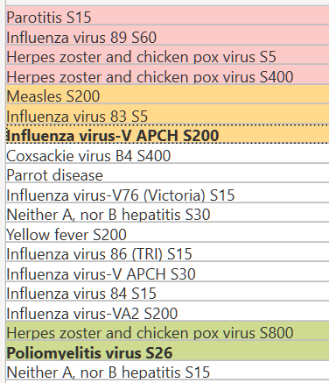
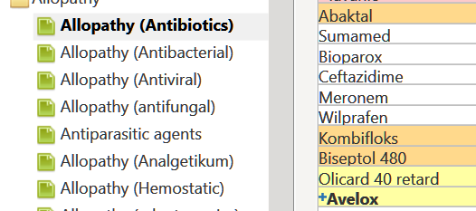
yellow 100

Slide 15
Homeopathy
We take FIRST WHITE 100 marker just below the Upper Orange zone. This is the most efficient.
Info about: Stabilisation
We use a STABILISATION only when the PATIENT is BLOCKED.
This is shown by markers and their uncontrollable and chaotic movements, leading to stopping h of the Compensation therapy.
In this case we use it for 3 mins. Then we with off the Program and we Restart again with a New Diagnoses and Compensation.
Always check the MANUAL .
You can find it in INFOS - The right upper Window on ERI Its highly recommended to study it or check anything you might need to know.
There is always a RULE: 50-50!
We can rely on: 50% up to 100% of judgement ONLY by ERI analyses
BUT
We have to take into consideration also a Patient's Feelings, problems and difficulties and make them to be analysed by ERI. This is another 50% up to 100%.
The END

