Slide 1
KME/ERI new mathematics and principles 2020 - WEBINAR

Slide 2
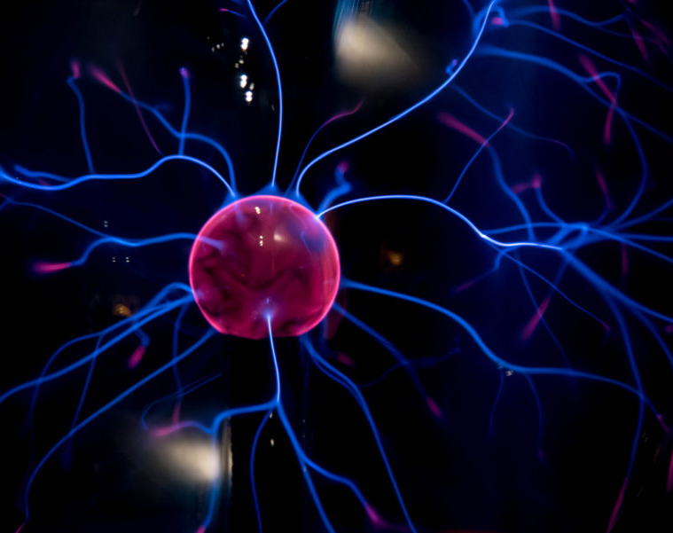
Main Markers ‘explanation always read the MANUAL first

Slide 3
Markers
Somatically or -10 psychosomatically = fast, quick, strong, rapid
100 somatically Or - 100 psychosomatically = slow, weakened, weak
50 Or -50 should then mean - STABILIZED. But sometimes especially in case of TOXINS - if shown by AUTOANALYSES - it can mean that the activity of that specific PATOGENS is getting changed.
----------------------------------------------------------------------------------------------------------------------------
Always check the ORRANGE ZONE: more stronger the activity = upper orange zone
lower activity = lower orange zone
Sometimes we can add for Compensation – the activities in 10 or -10 in yellow zone

Slide 4
ERI new principles
Right side = auto-analyses = PRIORITY – always the bottom marker or 2 can do the job
Left side - for more detailed analyses and treatment
------------------------------------------
Main indexes from the Right side - Autoanalyses
f.e.
Organs - you can see also markers: 1 – you go to Somato-psychological reactions
2 – you go according to the main marker in Causial chain – to Somatic or psychosomatic characteristics
All INDEXES and their meanings are explained in the MANUAL.

Slide 5
Left Side – Auto-analyses
The Left side - is Autoanalyses - which navigates us..
We can easily add into COMPENSATION what is shown on the LEFT SIDE, always 1 or 2 bottom markers /automatically/
The number of markers: maximum 27, optimum 14
We can just follow the left side, only if we realy want to help f.e. With faster healing, or pain or inflamation - we can add markers from the LEFT SIDE
We always check 10 or -10 in Orrange Zone for FAST REACTION, or 100 or -100 for SLOW reaction /it should have a logical sense/

Slide 6
New way of analyses …

